Slide 1
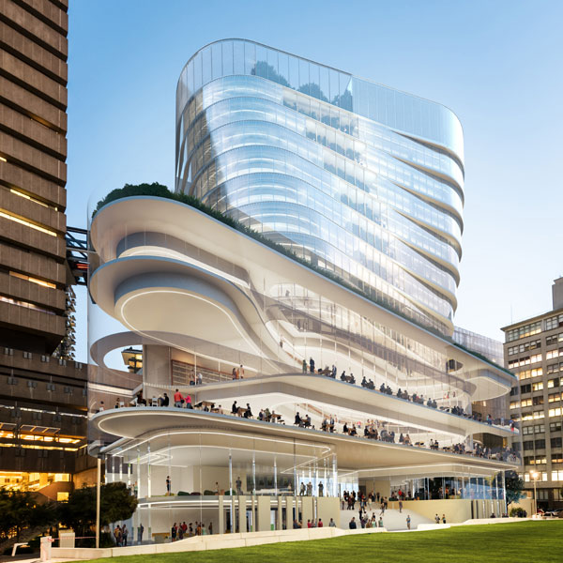
Tutorial Automated and Autonomous Predictive Modelling
Dr. Thanh Tung KHUAT
Complex Adaptive Systems Lab
The Data Science Institute and School of Computer Science
University of Technology Sydney
ThanhTung.Khuat@uts.edu.au
GitHub: https://github.com/UTS-CASLab/AutoML-Tutorial

Slide 2
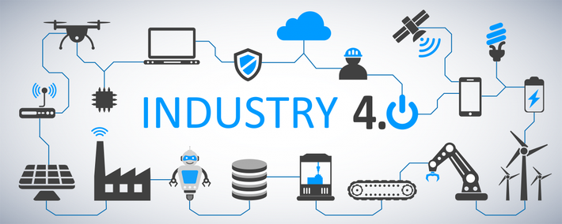
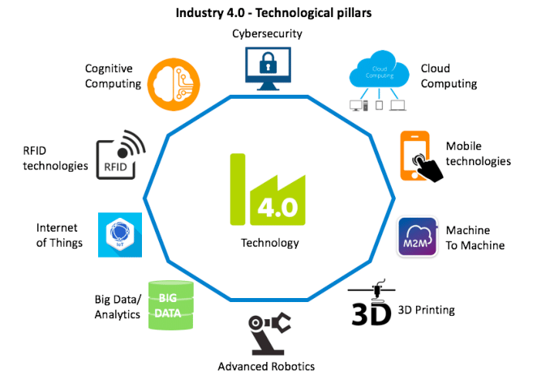
New Contexts in Industry 4.0
Source
BIG DATA

Slide 3
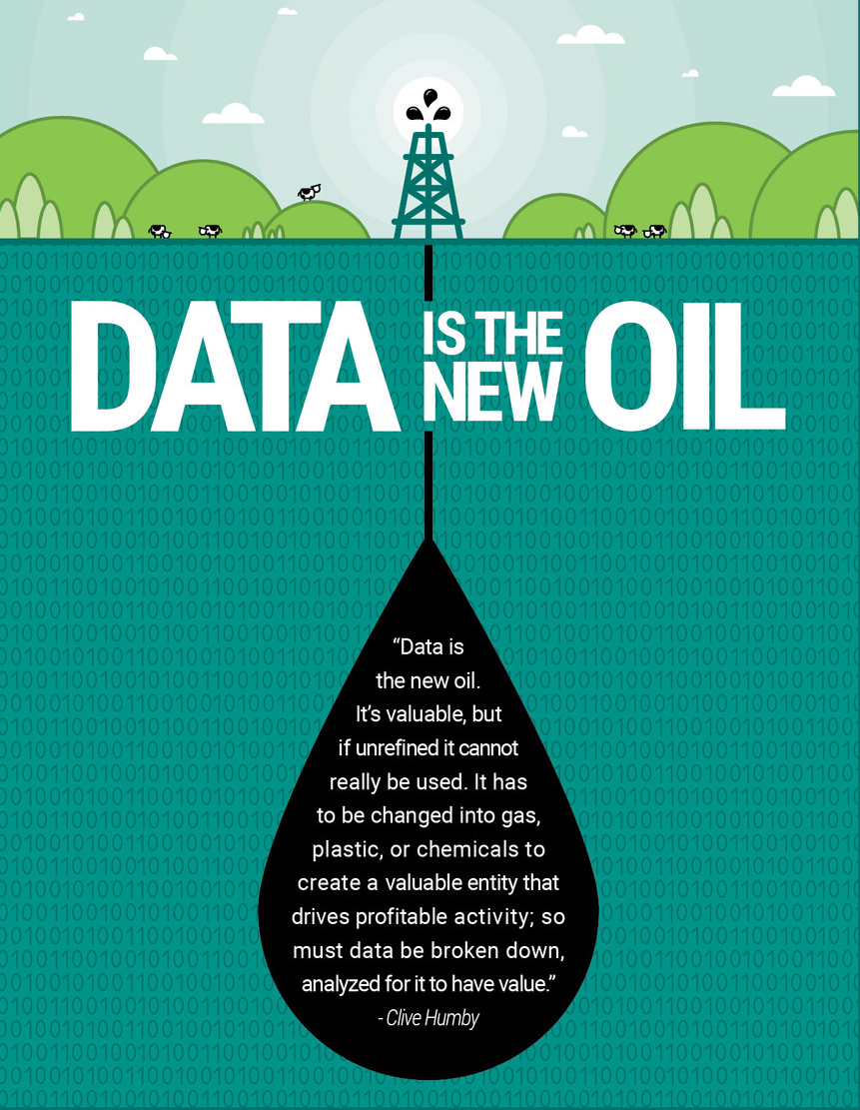
New Contexts in Industry 4.0
Data is the new oil. It’s valuable, but if unrefined it cannot really be used. It has to be changed into gas, plastic, or chemicals to create a valuable entity that drives profitable activity; so must data be broken down, analysed for it to have value.
- Clive Humby
Predictive Analytics
&
Data-Driven Machine Learning

Slide 4
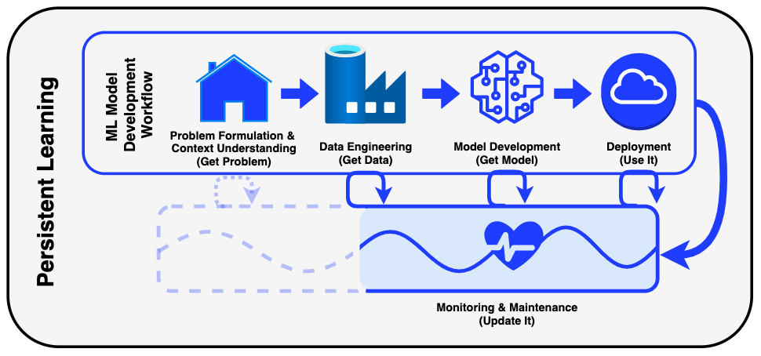
A General Machine Learning Workflow
Automated Machine Learning (AutoML)
Autonomous ML = AutoML + Persistent Learning + Adaptation

Slide 5
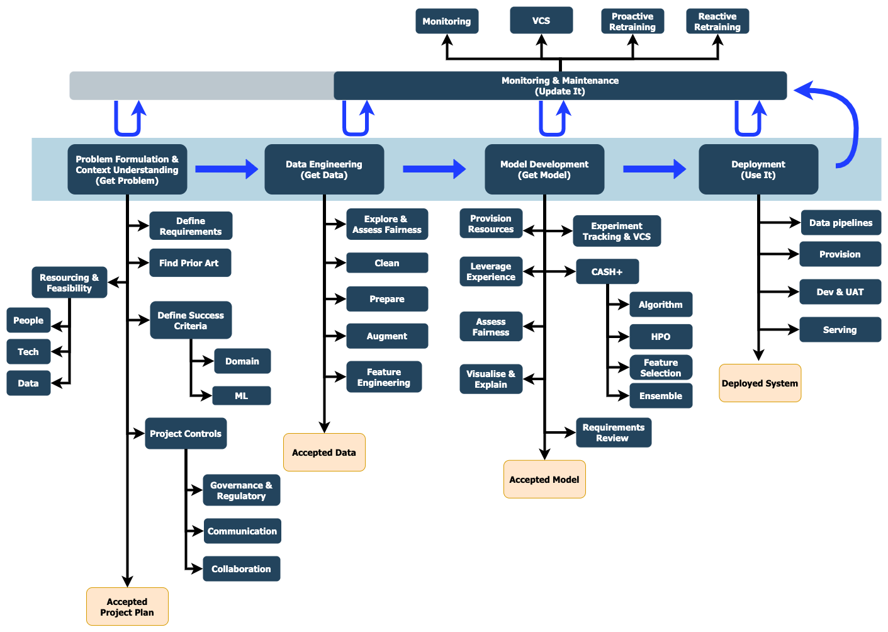
Machine Learning Workflow – Detailed View
Usually do NOT get sufficient attention in
research and development of AutoML
- VCS : Version Control Systems, e.g., Git
- CASH : Combined Algorithm Selection and
Hyperparameter Optimisation
Scriven, A., DJ Kedziora, K Musial, B Gabrys, “The Technological Emergence of AutoML: A Survey of Performant Software and Applications in the Context of Industry”, (Under review), 2022.

Slide 6
Automated Predictive Model Building – Considered Issues
Multicomponent Predictive System (MCPS)
CASH+: Automated Combined Algorithm Selection and
Hyperparameter Optimisation
Pre-processing
Model building
Continuous
Automation !!
DATA
Pre-processing
Model building
Post-processing
Deployment
Pre-processing
Model building
Update or retrain
Monitoring and Adaptation
A key aspect to ensure the good performance of learning systems in real world

Slide 7
Automated Predictive Model Building – Considered Issues
Meta-learning
Exploiting prior experience
A library stores the accumulation of previous experience
Solutions that worked well previously
Solution-finding procedures that worked well previously
How recognisable the current context is
Good suggestions are sent to the ML-pipeline planner or the ML-pipeline optimizer
Meta-knowledge
Meta-features
Seek similarity between datasets
Good learning models are associated with characteristics of datasets
Meta-models
A function from meta-features dataset to a recommendation
D.J. Kedziora, K. Musial, B. Gabrys, “AutonoML: Towards an integrated framework for autonomous machine learning”, ArXiv, 2020 (https://arxiv.org/pdf/2012.12600.pdf) (Section 7)

Slide 8
Automated Predictive Model Building – Considered Issues
Hyper-parameter Optimisation (HPO)
Black-box HPO methods
Reinforcement Learning
Evolutionary algorithms
Bayesian Optimisation
Gray-box HPO methods
Multi-fidelity optimization
White-box HPO methods
Hyper-gradients
See the paper for more information:
X. Dong, D.J. Kedziora, K. Musial, B. Gabrys, “Automated Deep Learning: Neural Architecture Search Is Not the End”, ArXiv, 2022 (https://arxiv.org/pdf/2112.09245.pdf)

Slide 9
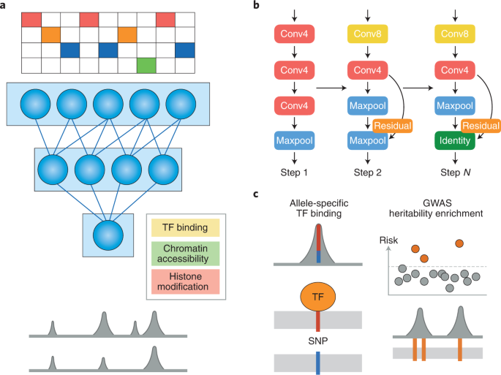
Automated Predictive Model Building – Considered Issues
Automated Deep Learning (AutoDL)
AutoDL
AutoML
NEURAL ARCHITECTURE SEARCH
Usually applied for unstructured data, e.g., image, text, sound
Source

Slide 10
Automated Predictive Model Building – Considered Issues
Automated Deep Learning (AutoDL)
Assessment Criteria for AutoDL solutions
Novelty
Solution quality
Efficiency
Stability
Interpretability
Reproducibility
Engineering Quality
Scalability
Generalizability
Eco-friendliness
See the paper for more information:
X. Dong, D.J. Kedziora, K. Musial, B. Gabrys, “Automated Deep Learning: Neural Architecture Search Is Not the End”, ArXiv, 2022 (https://arxiv.org/pdf/2112.09245.pdf)

Slide 11
AutoML Tools
Open source
Auto-sklearn
AutoGluon
H2O AutoML
AutoMLPipeline
TPOT
Auto-WEKA for MCPS
Pycaret
AutoKeras
Auto-Pytorch
Usually be used via CODE
More tools can be found in:
Scriven, A., DJ Kedziora, K Musial, B Gabrys, “The Technological Emergence of AutoML: A Survey of Performant Software and Applications in the Context of Industry”, (Under review), 2022.

Slide 12
AutoML Tools
2. Commercial Products
Data Robot
H2O Driverless AI
Dataiku
RapidMiner
KNIME
AWS SageMaker
Google Cloud AutoML
Microsoft Azure AutoML
Good Graphical User Interfaces
Easy for less experienced users in ML to use them
More tools can be found in:
Scriven, A., DJ Kedziora, K Musial, B Gabrys, “The Technological Emergence of AutoML: A Survey of Performant Software and Applications in the Context of Industry”, (Under review), 2022.

Slide 13
DEMO
We will demonstrate how to use an open-source AutoML Toolbox:
H2O AutoML
(Link to Notebook)

Slide 14
References
A scikit-learn compatible hyperbox-based machine learning library in Python is developed by CASLab – hyperbox-brain
Home page: https://uts-caslab.github.io/hyperbox-brain/
GitHub: https://github.com/UTS-CASLab/hyperbox-brain
Documentation: https://hyperbox-brain.readthedocs.io/en/latest/
PyPi: https://pypi.org/project/hyperbox-brain/
Survey papers
Scriven, A., DJ Kedziora, K Musial, B Gabrys, “The Technological Emergence of AutoML: A Survey of Performant Software and Applications in the Context of Industry”, 2022 (Coming soon).
X. Dong, D.J. Kedziora, K. Musial, B. Gabrys, “Automated Deep Learning: Neural Architecture Search Is Not the End”, ArXiv, 2022 (https://arxiv.org/pdf/2112.09245.pdf)
D.J. Kedziora, K. Musial, B. Gabrys, “AutonoML: Towards an integrated framework for autonomous machine learning”, ArXiv, 2020 (https://arxiv.org/pdf/2012.12600.pdf)
T. T. Khuat, D.J. Kedziora, B. Gabrys, “The Roles and Modes of Human Interactions with Automated Machine Learning Systems”, ArXiv, 2022 (https://arxiv.org/pdf/2205.04139.pdf)

